Slide 1

Introduction to
Year 6
Tuesday 8th September 2026

Slide 2
Year 6 Team
Mrs Hasler: Monday, Tuesday PM, Thursday, Friday
Mrs Hua: Tuesday AM, Wednesday

Slide 3


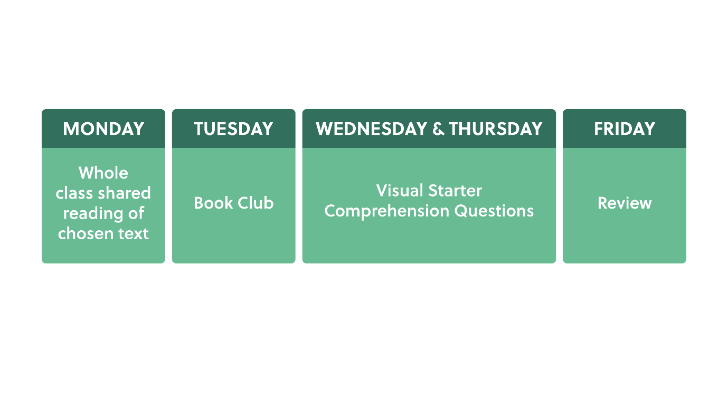
Reading
Retrieving
Clarifying
Summarising
Predicting
Questioning
Inferencing

Slide 4
Reading
Reading at home – 4 times per week
School library book
Accelerated reader quizzes once a book is complete
Love reading for kids https://www.lovereading4kids.co.uk/browse-by-age
Cranleigh library

Slide 5
Writing
Transcription and composition
Spellings – Oxford Owl
Y3/Y4 & Y5/Y6 Spelling lists
Handwriting joined and legible
By the end of Year 6, six pieces are assessed
Punctuation and grammar
Purpose and effect
Range of genres – linked to Master Readers text, school life, current affairs, images, video clips

Slide 6



Mathematics
Maths fluency – number bonds, times tables, subitising
Arithmetic
Reasoning and problem solving
Key facts (e.g. measures, number–squares, primes, multiples etc, months of year etc)

Slide 7
End of Key Stage 2 Assessment
Monday 10th May - Thursday 13th May 2027
Six written tests across four days.
Grammar and punctuation
Spelling
Reading
Mathematics Paper 1: Arithmetic
Mathematics Paper 2: Reasoning
Mathematics Paper 3: Reasoning
Writing and Science are teacher assessed.

Slide 8



Home learning
Daily home learning tasks. Aim to spend 10-15 mins per day.
Microsoft Teams to set tasks
Example timetable
Monday: Spag.com
Tuesday: Arithmetic
Wednesday: Maths Reasoning
Thursday: Spellings
•Reading at home
•TT Rockstars / Numbots
•Topic research

Slide 9
RE
Day by day scheme written by the Diocese
Scripture focus
Creation & Covenant – Genesis 2, Baptism, Science and faith in the story of creation
Prophecy & Promise – The role of women in the Bible: from Eve to Mary
Class Collective Worship: Tuesday 22nd September at 2.45pm

Slide 10
Science
Classifying Big and Small
Light and Reflection
Evolution and Inheritance
Circuits, Batteries and Switches
Circulation and Health

Slide 11
RSE/PSHE
Age-appropriate and carefully planned curriculum
The programme is designed specifically for Year 6 pupils and prepares them for the transition to secondary school. Content is taught sensitively, progressively and in a way that is appropriate to children's age and stage of development.
Healthy relationships and personal safety
Helps children understand healthy friendships, boundaries, consent, peer pressure, online safety and where to seek help if they feel worried or unsafe. Safeguarding is at the heart of the programme.
Partnership with parents
We believe parents are the primary educators of their children and we will endeavour to work closely with all of our families.

Slide 12
Curriculum
Geography: How does population change?
History: What was the impact of WW2 on the people of Britain?
Art: Craft and design – photo opportunity
D&T: Structures – Playground pioneers
Computing: Webpage creation
Spanish
PE: Thursdays and Fridays

Slide 13

Y6 Leadership Structure
Wellbeing Ambassadors
Digital Champions
Faith Council
Healthy Schools
STEM Team
(Science, Technology, Engineering + Maths)
Eco Warriors
Equality, Diversity and Inclusion
Sports
Reading Ambassadors
Outdoor Environment
Art

Slide 14
Attendance
Every day matters – Good attendance supports children's learning, confidence, friendships and overall wellbeing.
Aim for 96%+ attendance – Even small amounts of absence can add up over time and impact progress across the curriculum
Be on time, every time – Arriving punctually helps children settle quickly, start learning positively and avoid missing important teaching.
Holidays should not be taken during term time – Leave of absence can only be authorised in exceptional circumstances by our Headteacher.
Appointments – As much as possible, please avoid appointments during the school day

Slide 15
School uniform
High expectations
Jewellery: stud earrings, simple watch. All jewellery including earrings must be removed for PE
Simple hair accessories in school colours
School shoes not black trainers
No smart watches
Warm, waterproof coat with a hood
Please name everything

Slide 16
Other information
Walking home alone – permission must be given on Arbor
Parents to log in to Arbor half termly to ensure all details are up to date
Mobile phones – brick phones only with no internet – children hand in to the school office
Focus/fidget toys supplied by school as needed. None from home are allowed in
No other belongings, e.g. toys, teddies, cards
Bring water bottles – names
Healthy snacks for break – no nuts or fizzy drinks

Slide 17
CYE Residential
Monday 14th June – Friday 18th June 2027
4 night residential
Chichester harbour
Range of water based and land based activities
Beach day
Spiritual focus, daily assemblies

Slide 18
Other trips
Junior Citizen event at Guildford Spectrum June 2027 – approx £12 per child
Wintershall Leavers Retreat – Tuesday 13th July – approx £12 per child
Geography fieldwork in Cranleigh – Start of October (date TBC)

Slide 19

Questions?

